Slide 1

Economic opportunity, public policy, and population health
Atheendar Venkataramani, MD PhD
Director, Opportunity for Health Lab
Assistant Professor
Division of Health Policy, University of Pennsylvania
March 1, 2022

Slide 2
Disclosures
Research support from:
  National Institutes of Health
  Robert Wood Johnson Foundation
  Thomas G. Roberts Jr, MD and Susan M. DeSilva, DNP Giving Fund
  Independence Blue Cross (IBX)

Slide 3
Mission and outline
Empathy
Innovation
Impact

Slide 4
Empathy
Using real world experience and data to elucidate what really matters for the health and well-being of individuals and populations.

Slide 5
Hope, opportunity, and health
”What’s the point? I’m not getting out of here anyway.”
-Mr. M, age 33

Slide 6
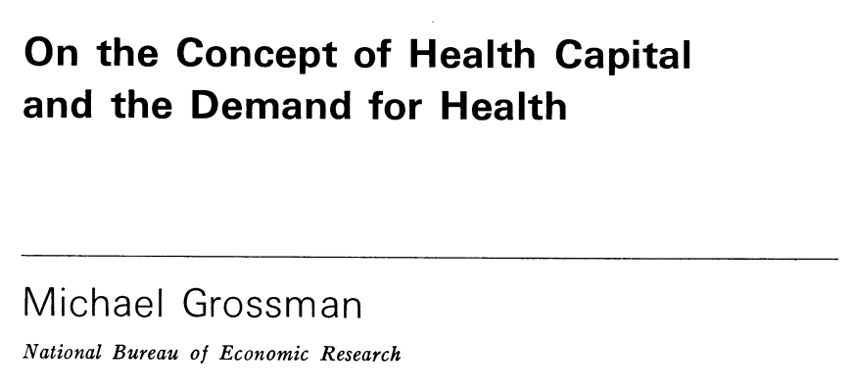
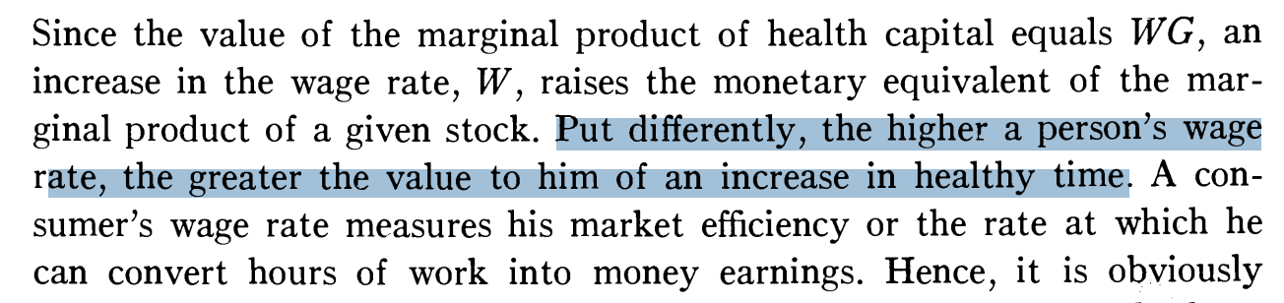
Why does opportunity matter for health?
Opportunity – prospects for upward social mobility (“The American Dream”)
Grossman JPolEcon 1972

Slide 7
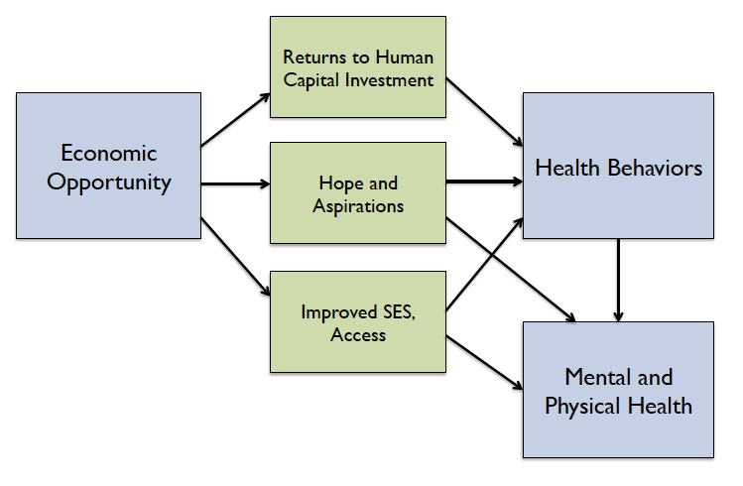
Why does opportunity matter for health?
Venkataramani et al AJPH 2016

Slide 8
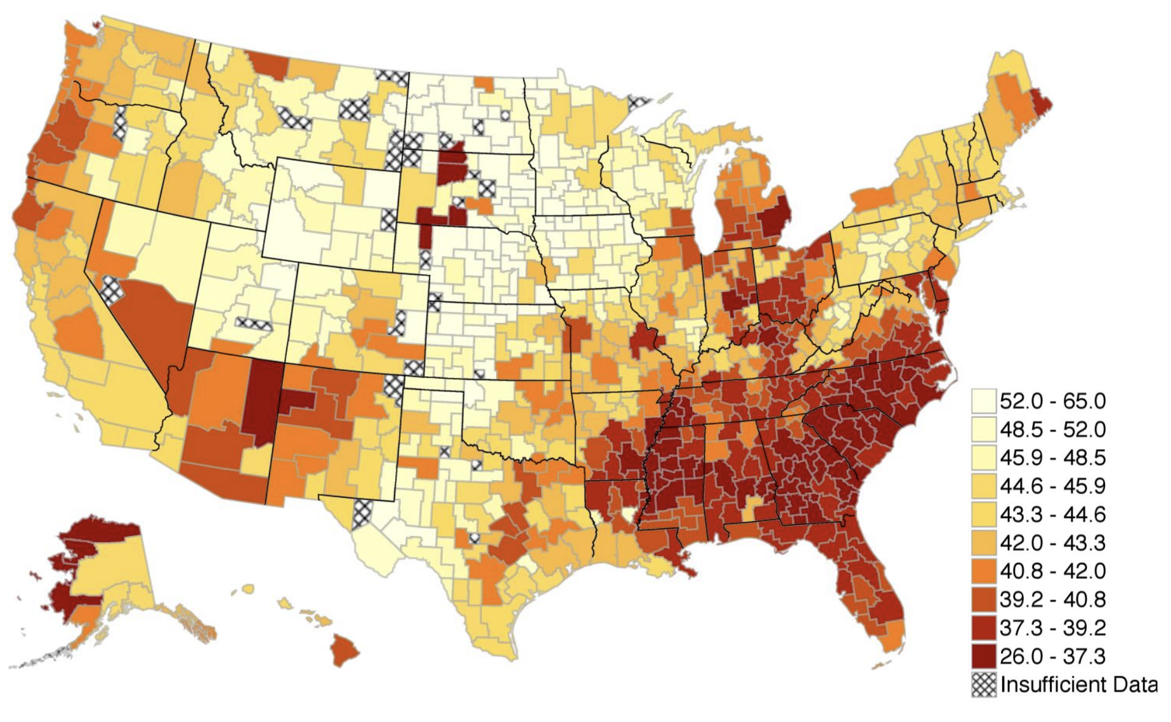
Early correlations
Adjusted mortality rates were 17% lower in high opportunity counties.
Castro et al J Immig Minor Health 2010; Chetty et al QJEcon 2014; Venkataramani et al AJPH 2016, Lancet PH 2017, JAMA IM 2020; O’Brien et al Epidem 2017; Gugushvilli et al Soc Sci Med 2022

Slide 9
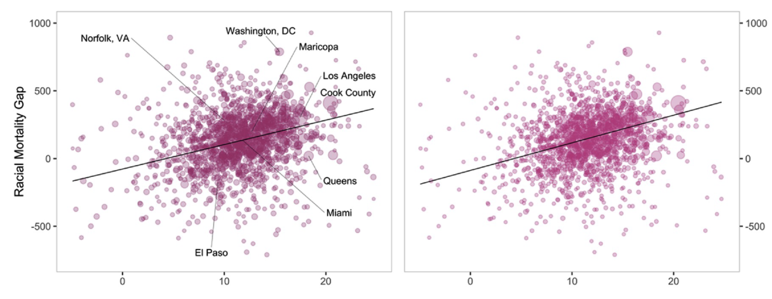
Opportunity structures
Chetty et al QJ Econ 2018; O’Brien et al SSM Pop Health 2020; Zang and Kim Health Place 2021

Slide 10
Establishing causality
Correlations may be biased by unobserved factors
Social policies, events, and economic shocks as “natural experiments”
  Similar people may be treated differently for arbitrary reasons
  Immediate relevance to decision-makers
Illustrative case studies
  Plant closures, immigration policy, affirmative action

Slide 11
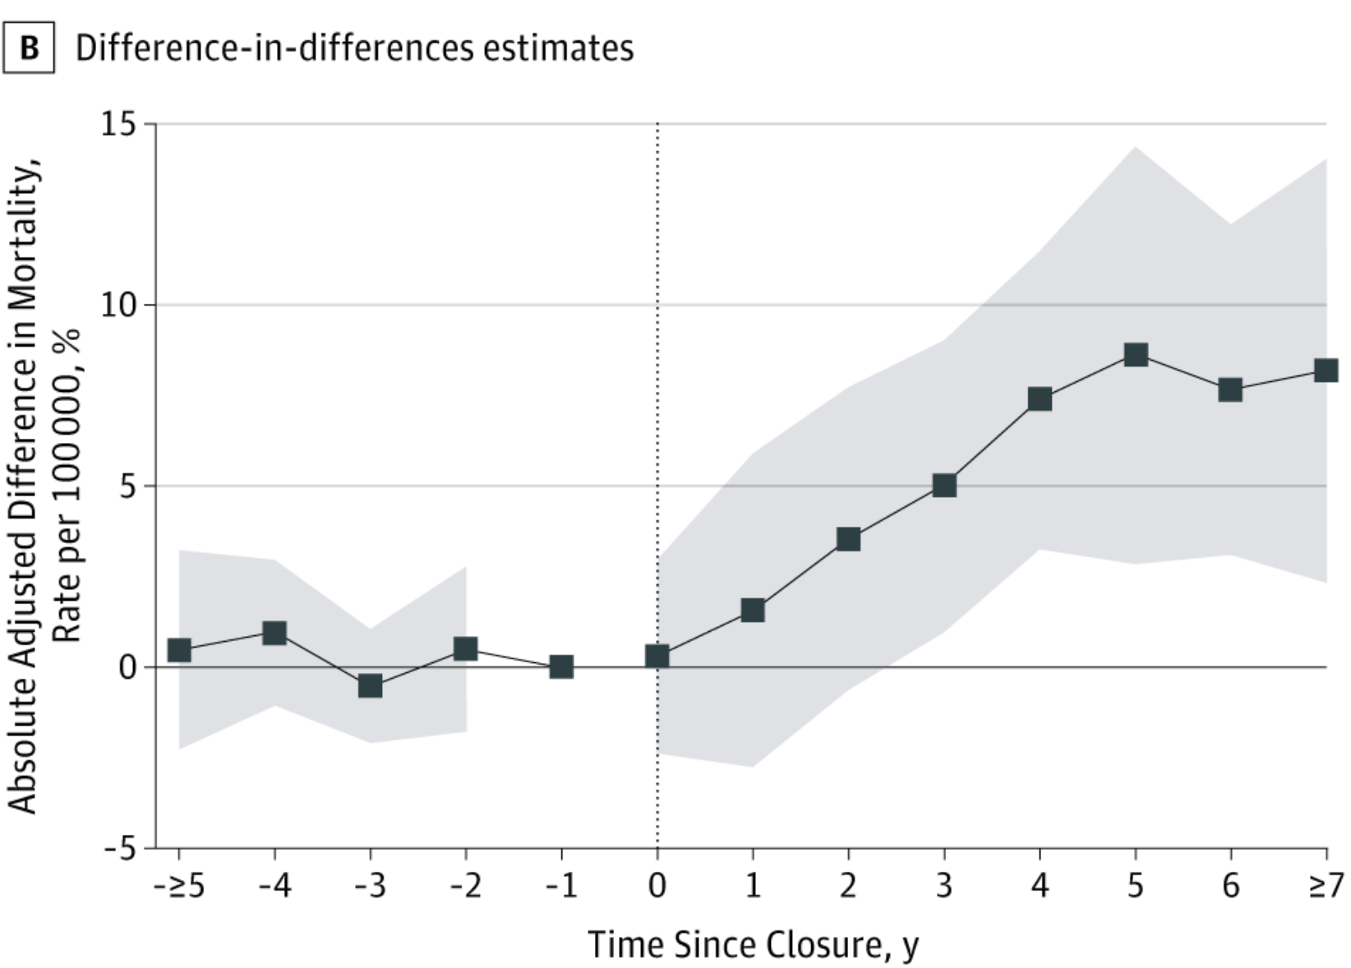
Industrial plant closures and automation
85% relative increase.
Case and Deaton PNAS 2015, 2021; Pierce and Schott AER Insights 2020; Venkataramani et al JAMA IM 2020; Seltzer SSM Pop Health 2020; O’Brien et al Demography 2022

Slide 12
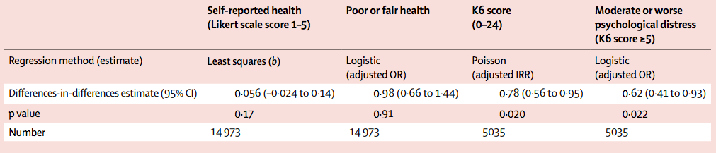
Immigration policy – the DACA program
Venkataramani et al Lancet PH 2017; Hainmuller et al Science 2017; Venkataramani et al JAMA Peds 2018; Patler et al Health Aff 2019; Giuntella et al J Econ Behav Org 2021

Slide 13
State-level affirmative action bans
20% relative increase in smoking
(and 12% increase in alcohol use)
Smoking effects persist into adulthood
Venkataramani et al PLoS Medicine 2019; Akhtari et al NBER WP 2020; Bleemer QJ Econ 2022

Slide 14
Innovation
Using rigorous methods to identify new interventions to bolster health and well-being.

Slide 15
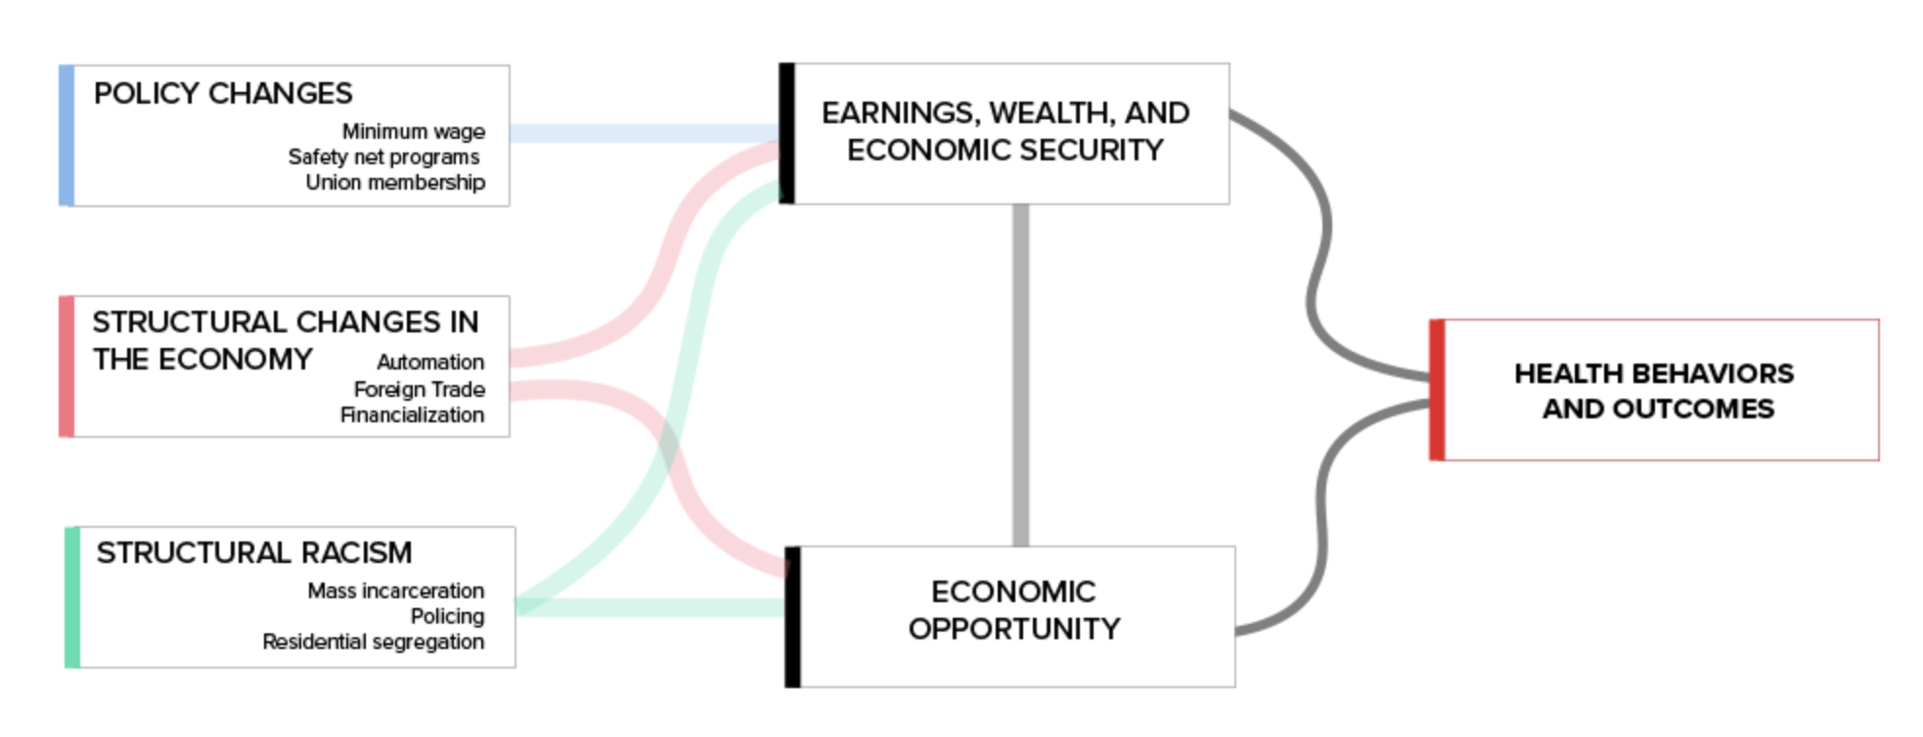
Broadening our scope
Venkataramani et al PLoS Medicine 2020

Slide 16
Scientific areas moving forward
Basic science
Plumbing
Turning inward
Interventions

Slide 17
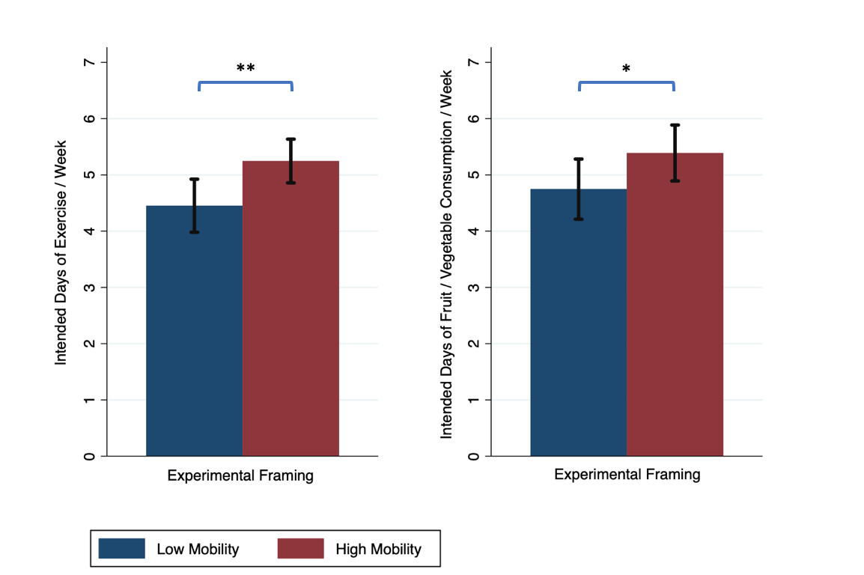
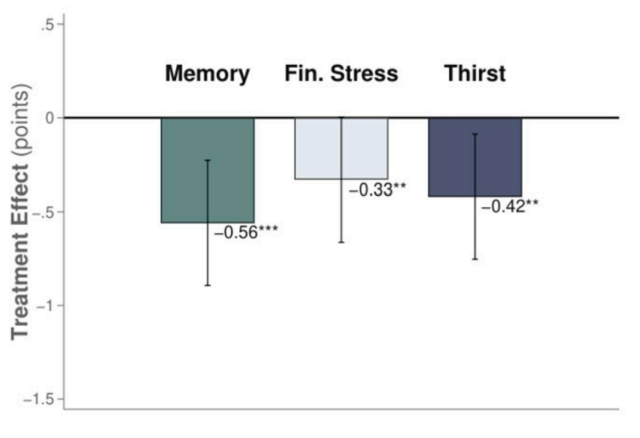
Basic science: psychology of opportunity
OfH Lab pilot data 2020; Browman et al J Exp Soc Psych 2017;
Schofield and Venkataramani PNAS 2021; Banerjee et al Science 2015 and AER Insights 2021

Slide 18
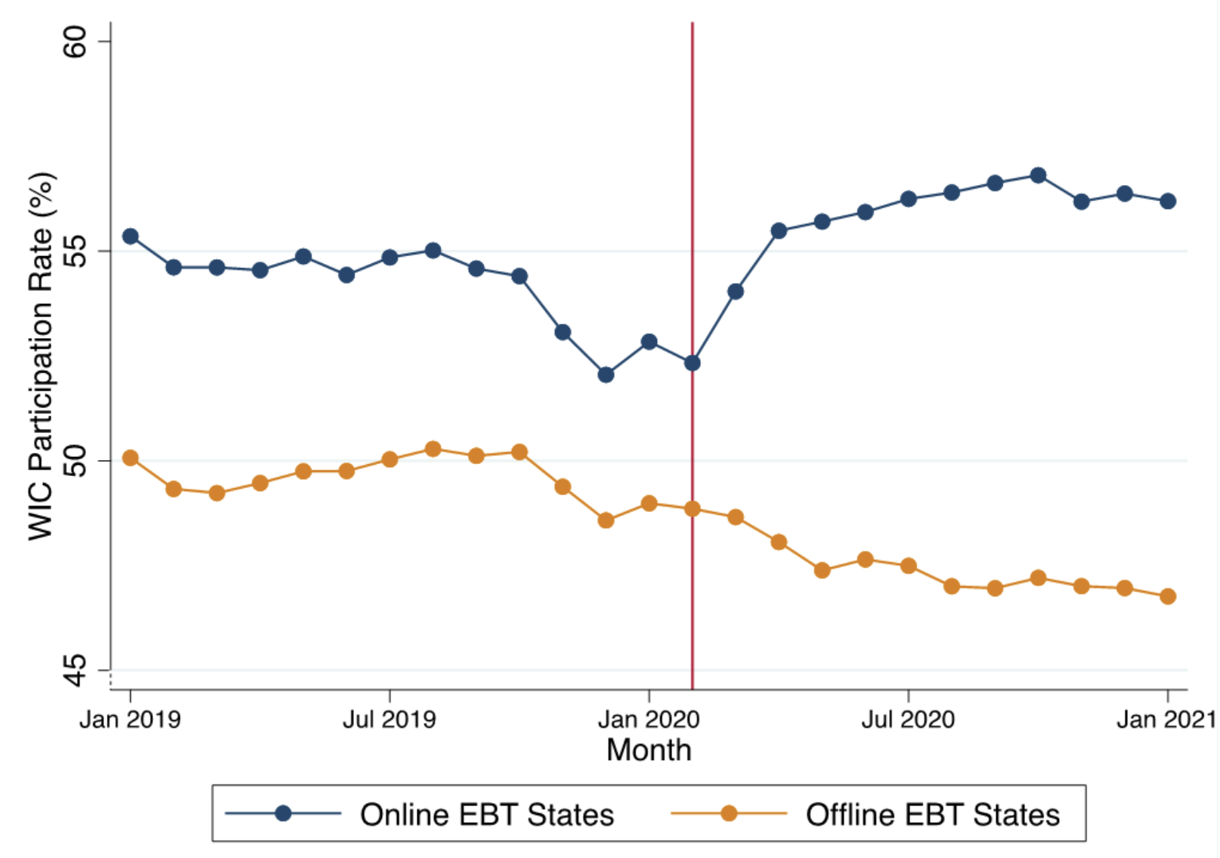
Plumbing: improve social program design
Herd and Moynihan Admin Burden 2018; Vasan et al JAMA Pediatrics 2021; Vasan et al JAMA 2021

Slide 19
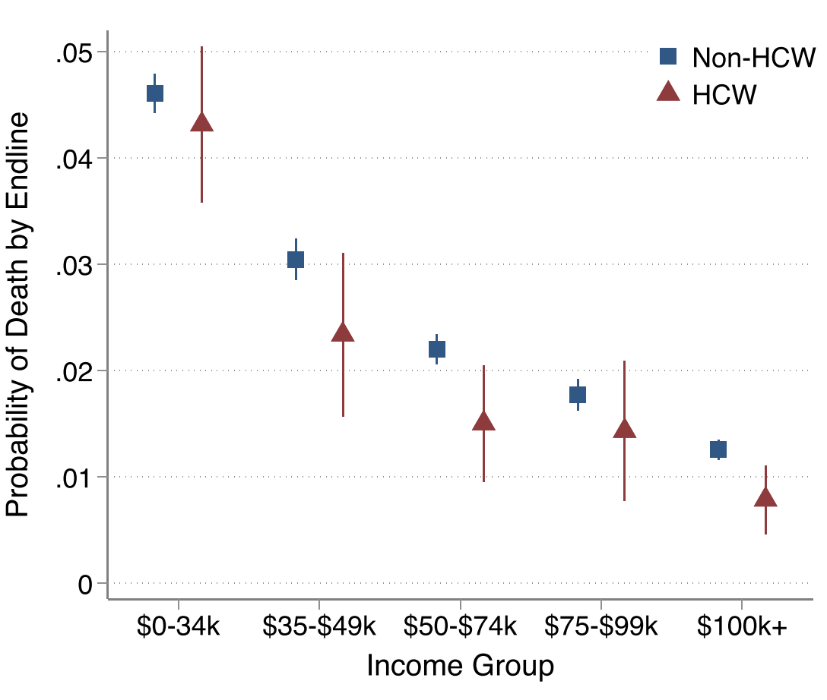
Turning inward: health care workforce
Himmelstein and Venkataramani AJPH 2018; Matta et al JGIM 2021

Slide 20
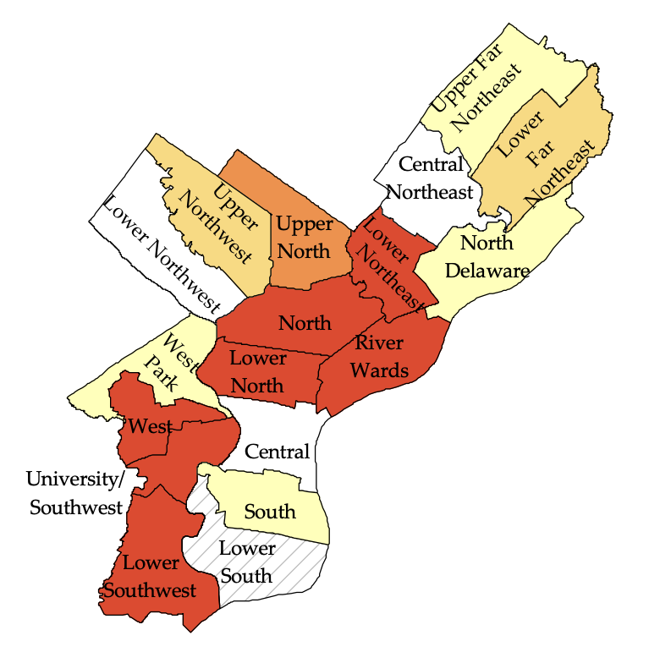
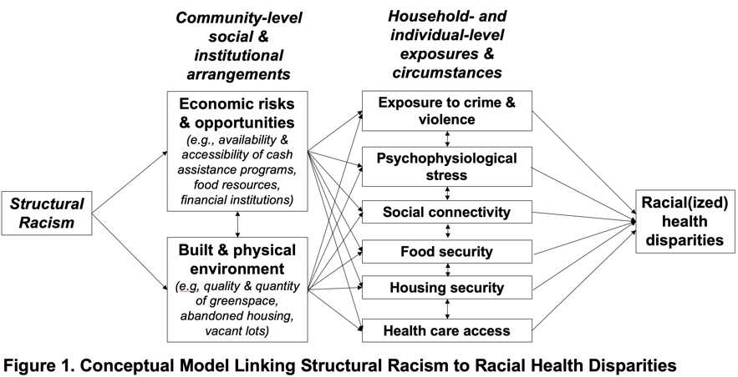
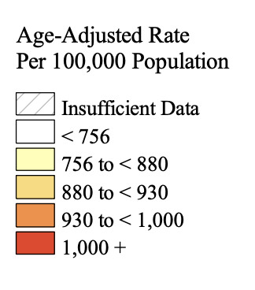
Interventions: IGNITE study
Phelan and Link Ann Rev Sociology 2015

Slide 21
Interventions: IGNITE study design
Environmental justice
  Vacant lot greening (150)
  Abandoned house remediation (90)
  Tree planting (300)
  Trash clean-up (weekly)
Economic justice
  Tax preparation (360 people)
  Connection to Benefits (360)
  Financial counseling (360)
  Emergency cash grants (180)
60 clusters (4x4 block areas)
Enroll 720 adults (12/cluster)
Randomly selected 30 (360 clusters receive intervention
Branas et al PNAS 2018, South et al JAMA Netw Open 2018; O’Brien et al Soc Sci Med 2018; Venkataramani et al PLoS Med 2020; Vasan et al JAMA 2021; Stockton Demo Report 2020; Dalembert et al NEJM Catalyst 2021; Goldin et al JPubEcon 2022

Slide 22
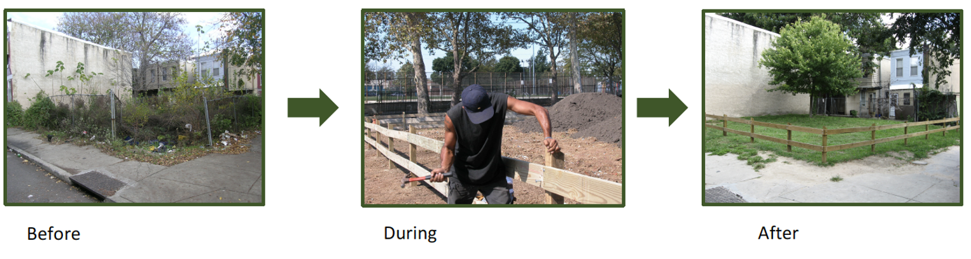
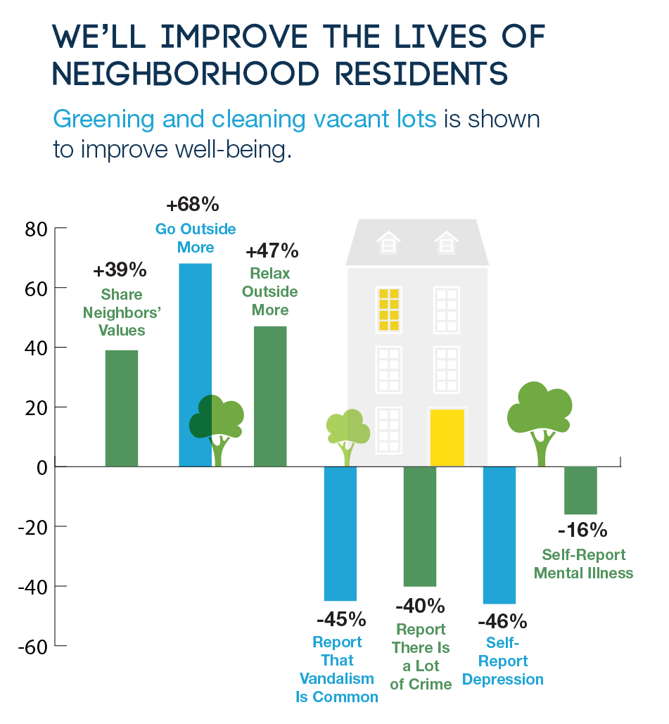

+ 76%
+ 58%
28%
Nuisance Calls
29%
Gun Violence
39%
37%
41%
Branas et al PNAS 2018, South et al JAMA Netw Open 2018

Slide 23
Interventions: IGNITE study outcomes
Secondary
Blood pressure
Health care utilization
Violent crime
Food security
Social connectedness, discrimination
Financial security, benefit uptake, money returned on taxes
Qualitative
Study participants (subset)
Leaders of community orgs, policy makers, other stakeholders (implementation)
Primary
Short Form Health Survey (SF-36)
Psychological distress

Slide 24
Impact
Ensure that scientific findings help guide policymaking and lead to lasting, positive impacts on health.

Slide 25
Ensuring science actually matters.
Dissemination
Active engagement
Collaboration and training

Slide 26
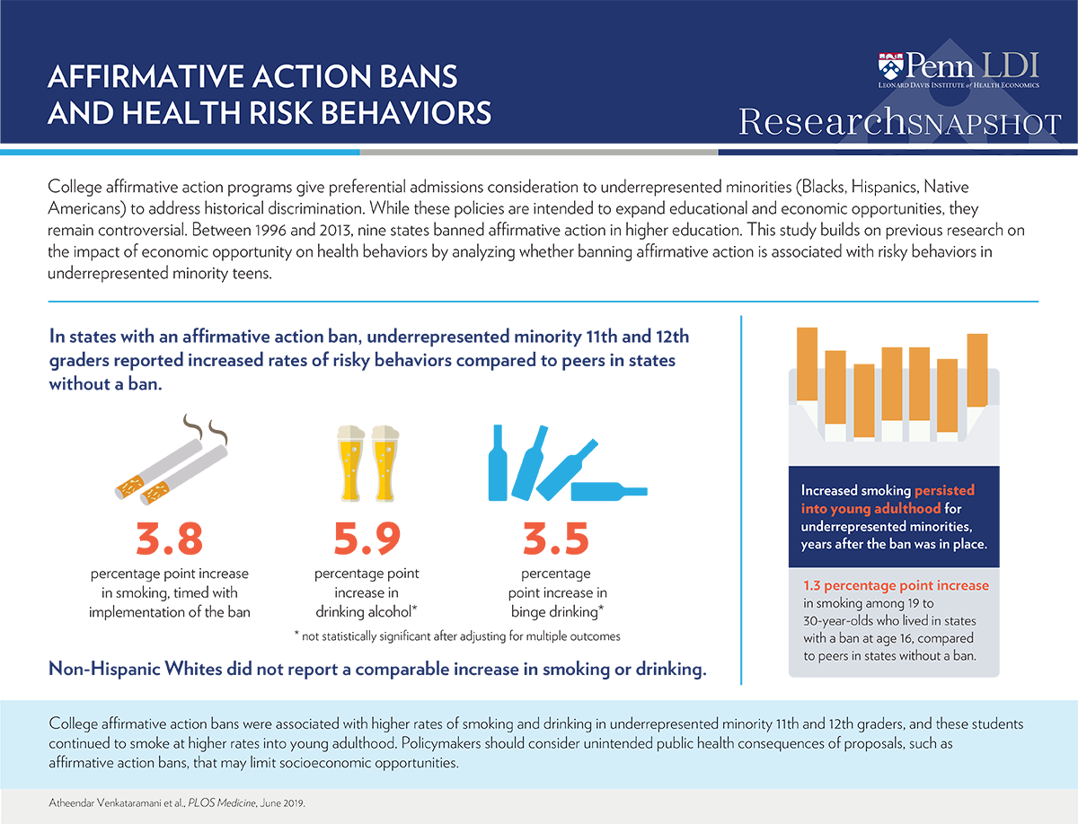


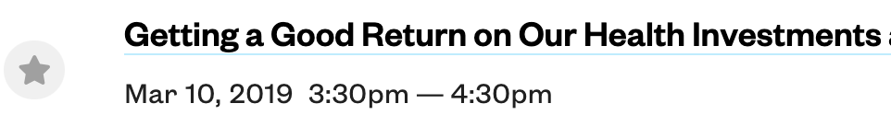

Disseminating widely…

Slide 27




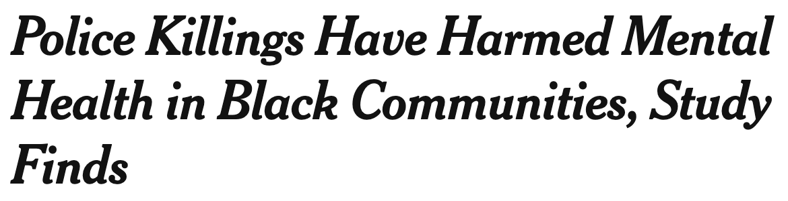
…and across political divides

Slide 28
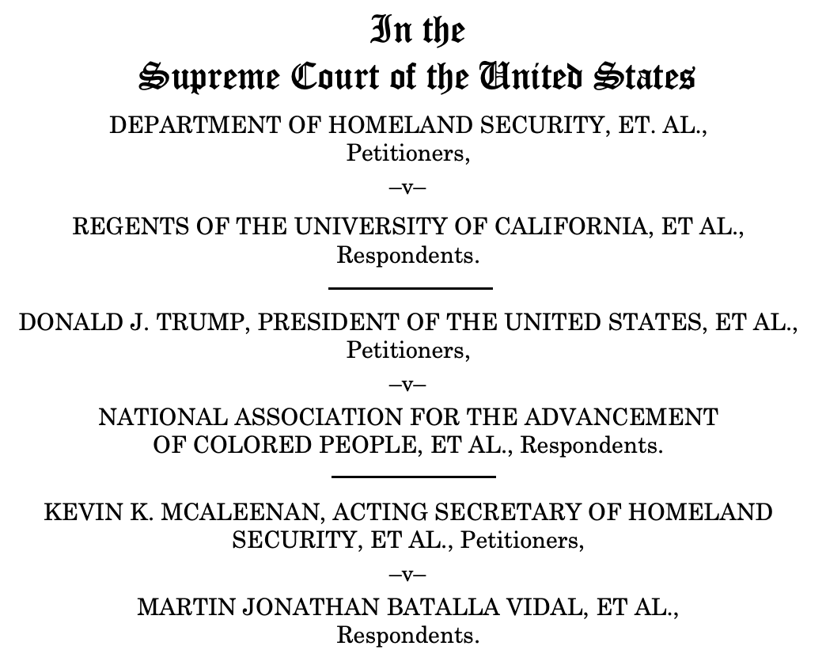

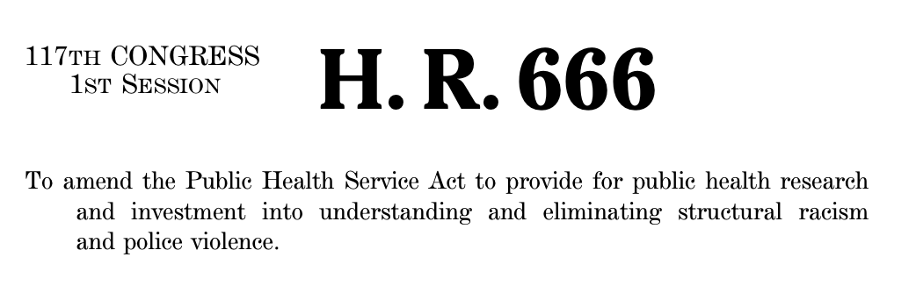
Engaging changemakers: evidence for action

Slide 29
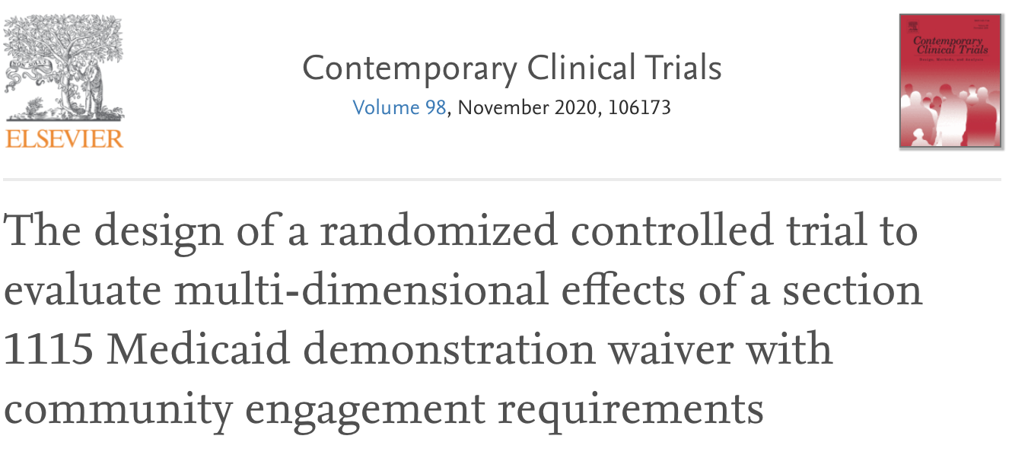

Engaging changemakers: proactive science
Venkataramani et al JAMA 2020; Linn et al Contemp Clin Trials 2021; Venkataramani JPAM 2021; Wallace et al NEJM forthcoming

Slide 30



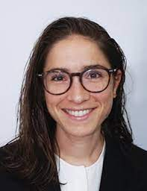




“Doing hard things with friends”

Slide 31
Acknowledgements
Funders: Robert Wood Johnson Foundation, National Institutes of Health, U.S. Social Security Administration, Donaghue and Rx Foundations,
Great mentors, including Allen Kelley, Jody Sindelar, Jason Fletcher, David Bangsberg, Alex Tsai, Mark Eisenberg, Geren Stone, Josh Metlay, Kevin Volpp, Zeke Emanuel, Rachel Werner, Grant Miller
Numerous co-authors and trainees

Slide 32
Thank you.
atheenv@pennmedicine.upenn.edu
OpportunityforHealth.org

